Slide 1
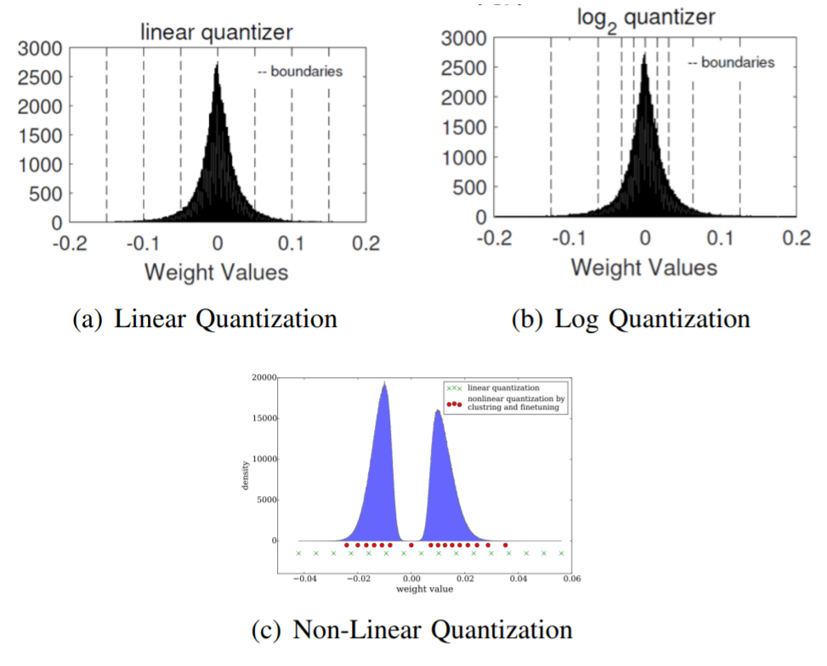

Slide 2
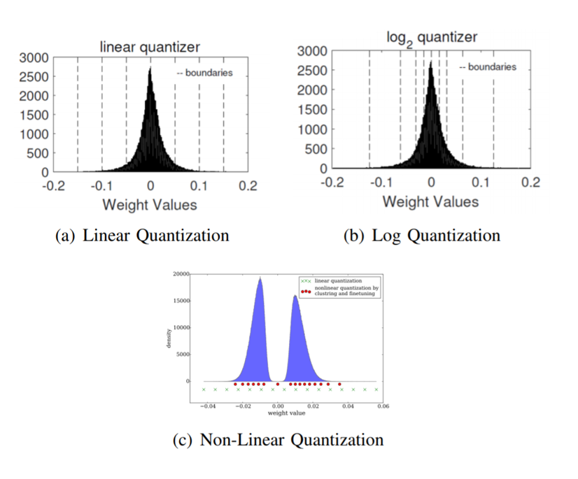

Slide 3
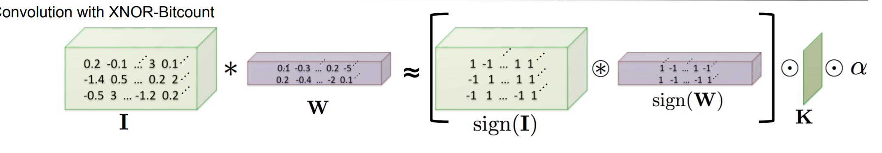
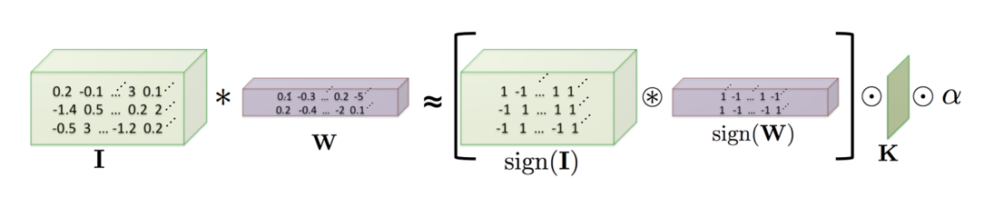

Slide 4
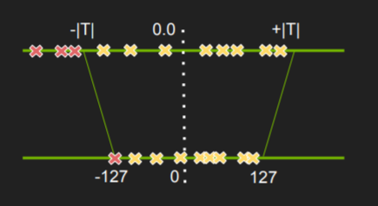

Slide 5
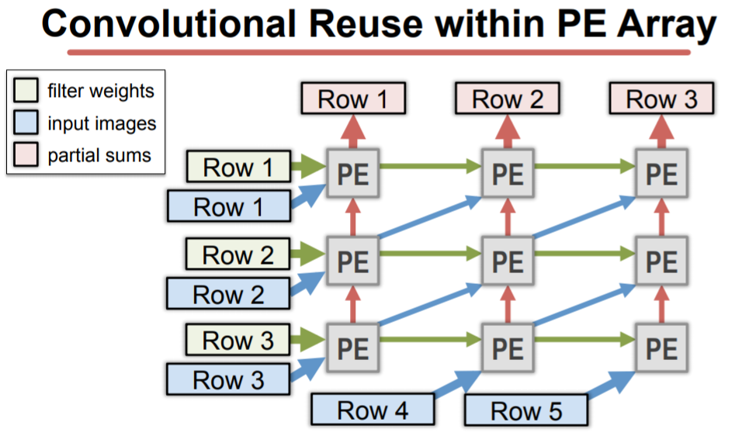

Slide 6
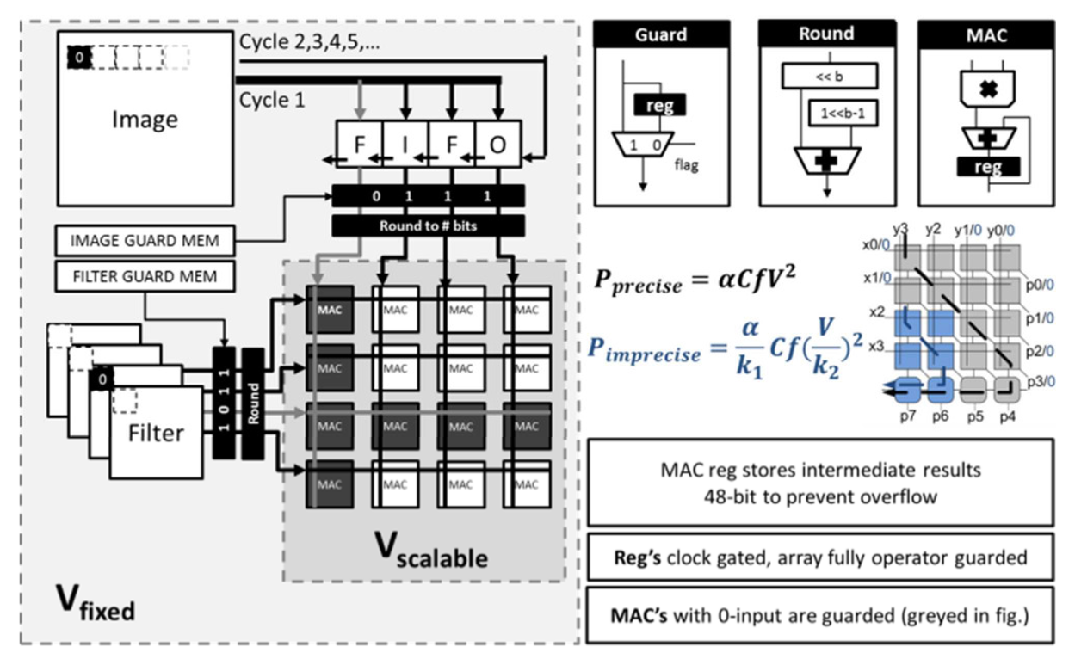
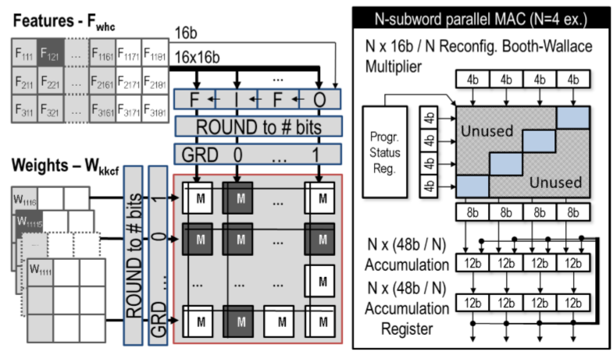
(a)
(b)

Slide 7
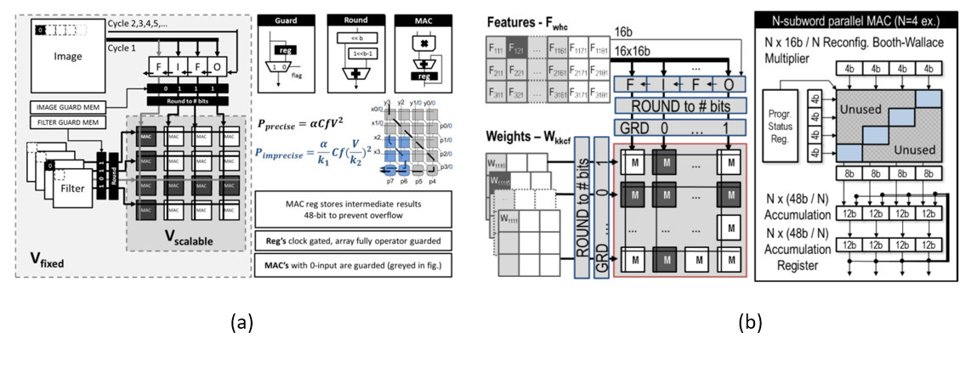

Slide 8
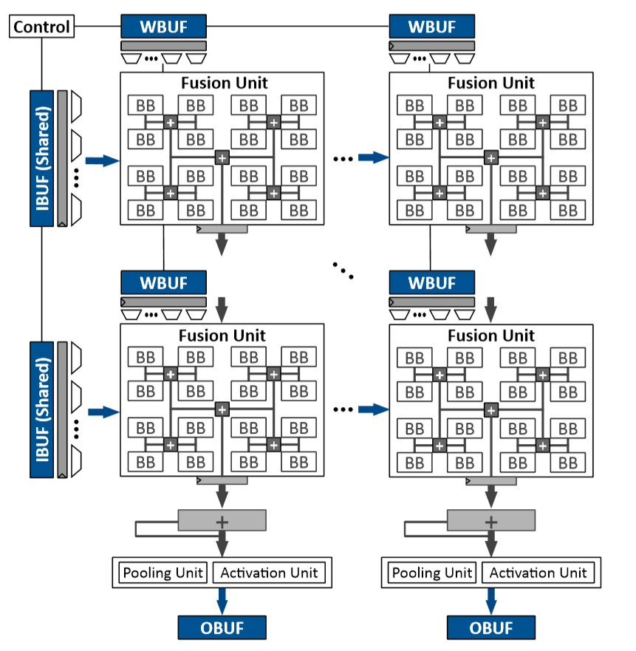
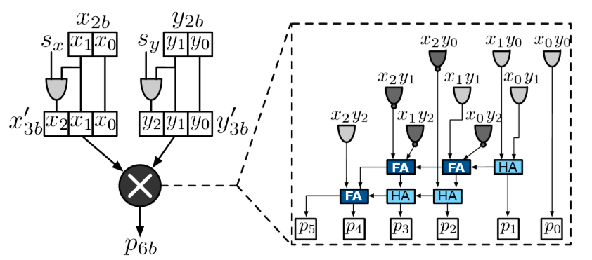
(a)
(b)

Slide 9
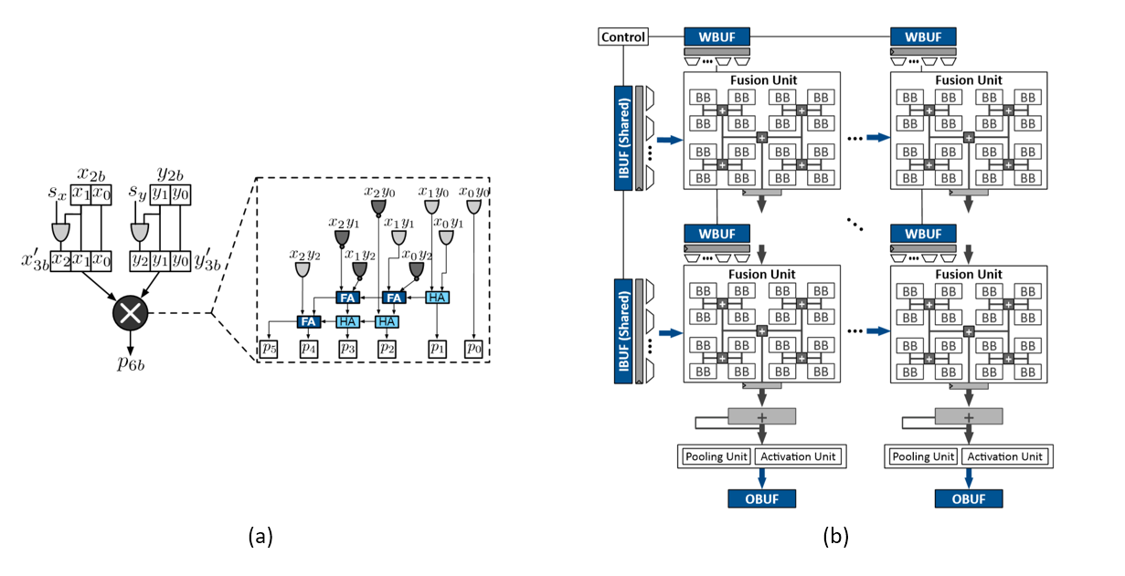

Slide 10
D_{q}
D_{q}
D
D_{r}
D_{r}

Slide 11
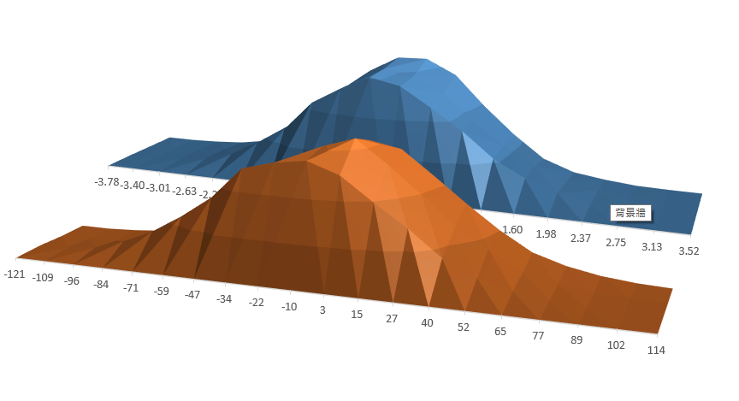

Slide 12
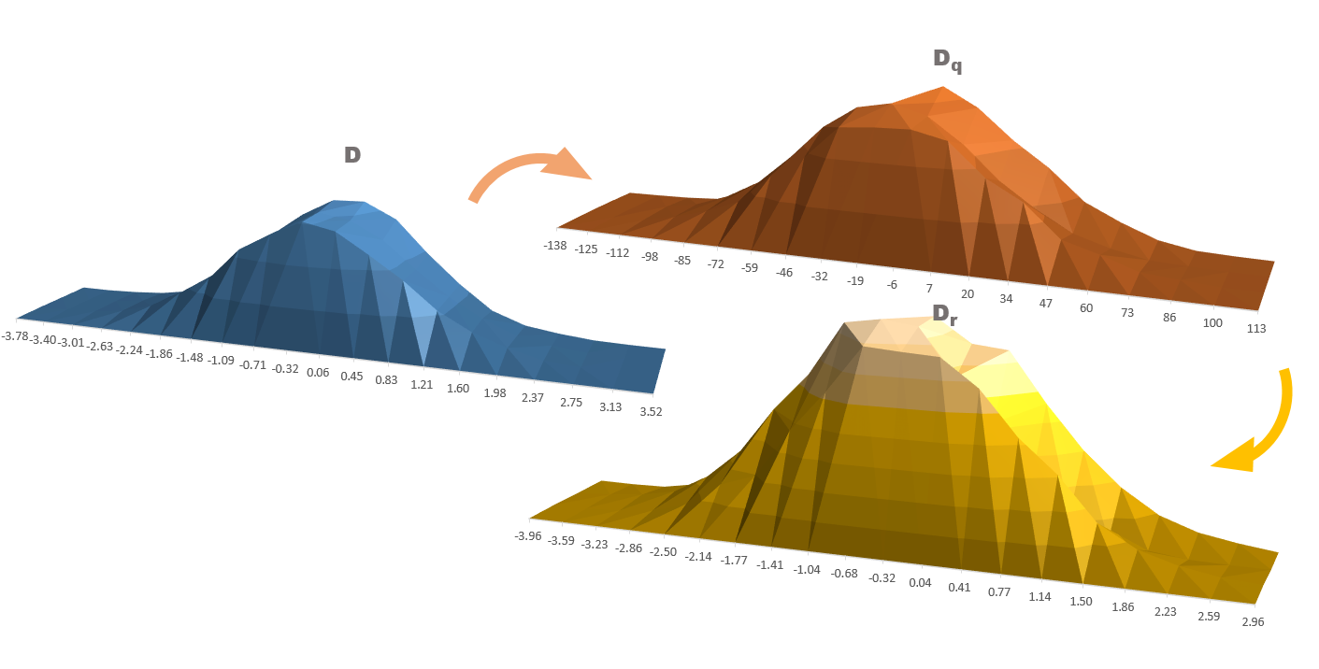

Slide 13
W
F
C
M
H
M
E
R
S

Slide 14
W
F
C
M
H
M
E
R
S

Slide 15
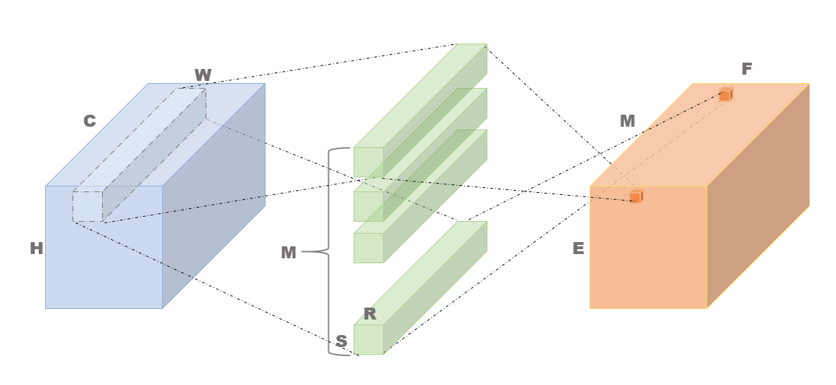
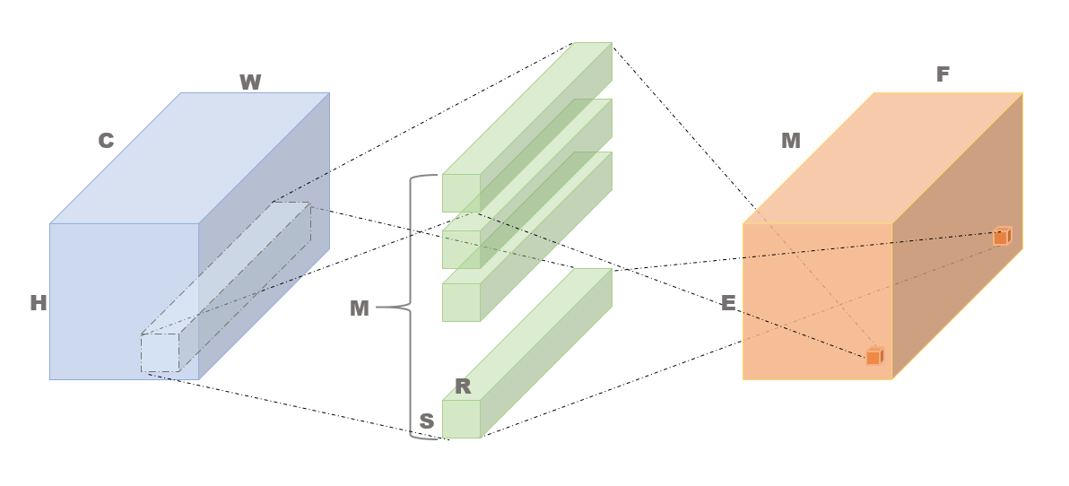
Input tensor
filter tensor
output tensor
(a)
(b)

Slide 16
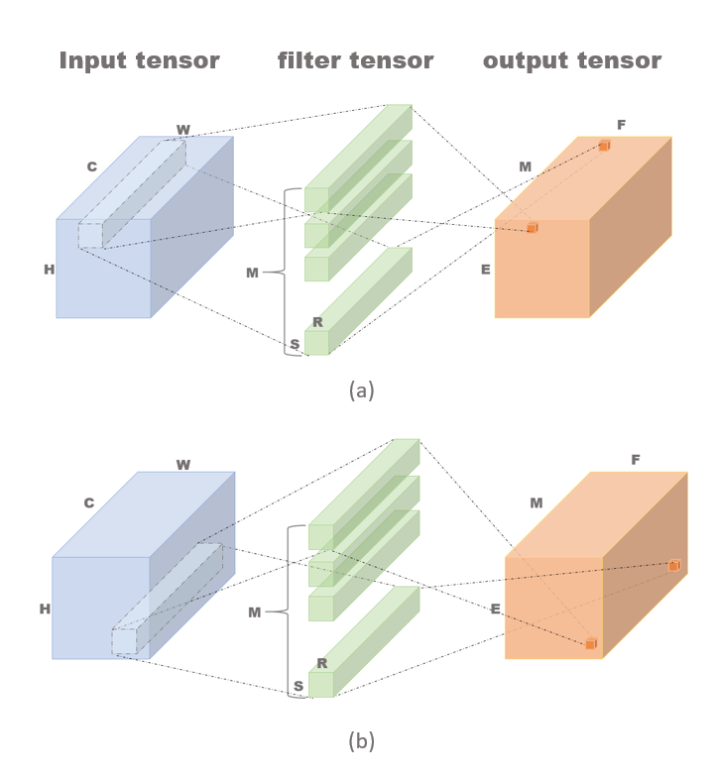

Slide 17
U
B
B

Slide 18
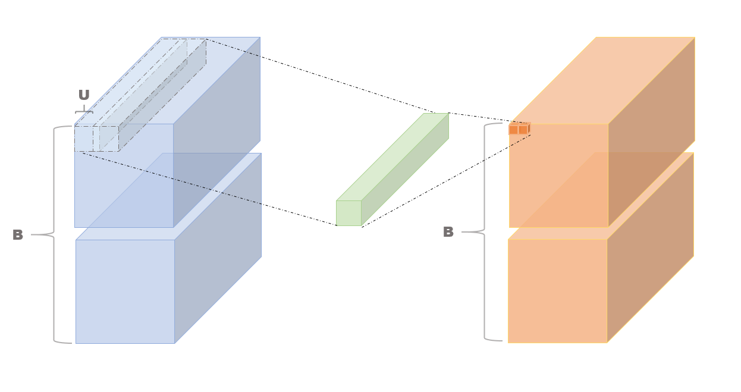

Slide 19






C
X_{b}=2
C/4

Slide 20
C
C/4

Slide 21
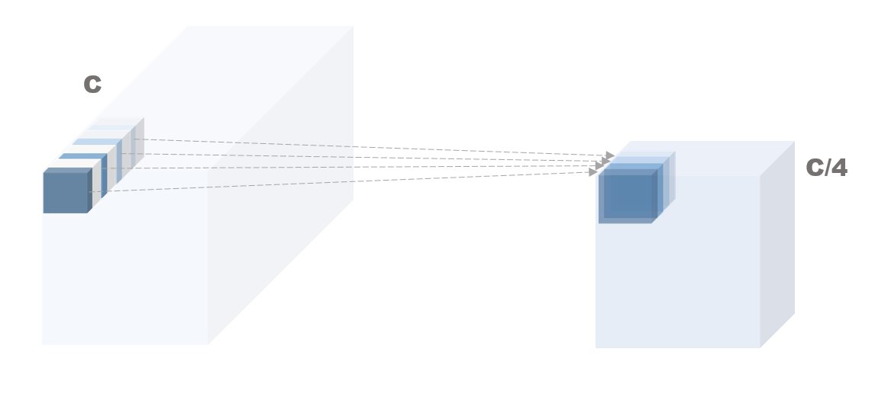

Slide 22
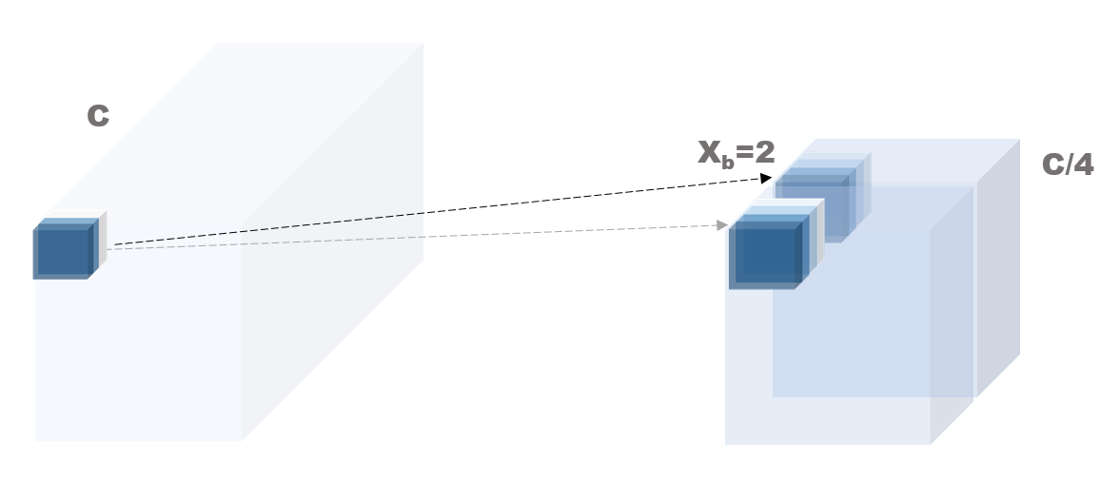

Slide 23
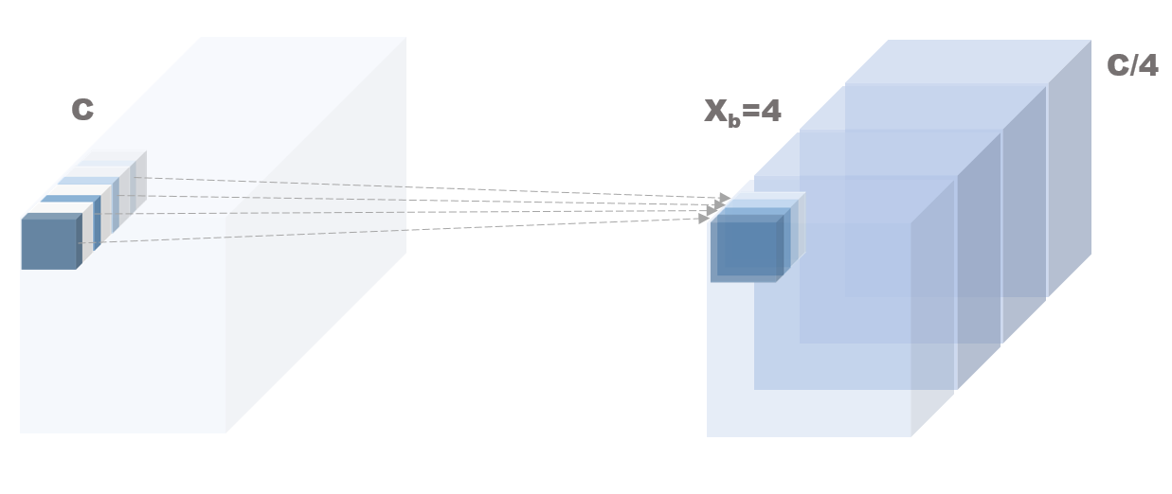

Slide 24
(T_{w}*U)-U+R
(T_{W}*U)-U+R
T_{W}
T_{m}
(T_{h}*U)-U+R
T_{h}
P_{ch}
T_{b}
T_{m}

Slide 25
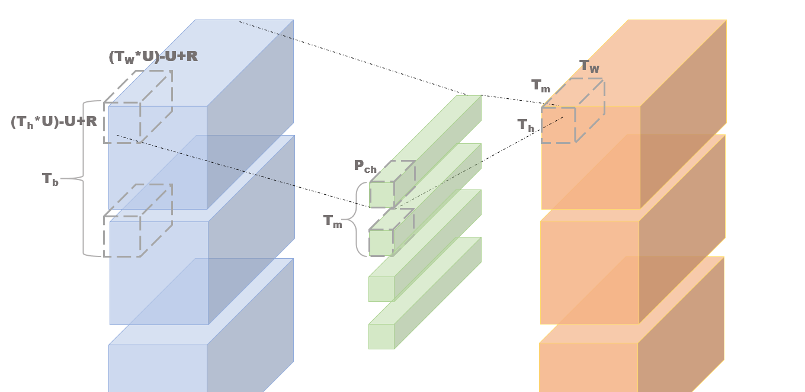

Slide 26
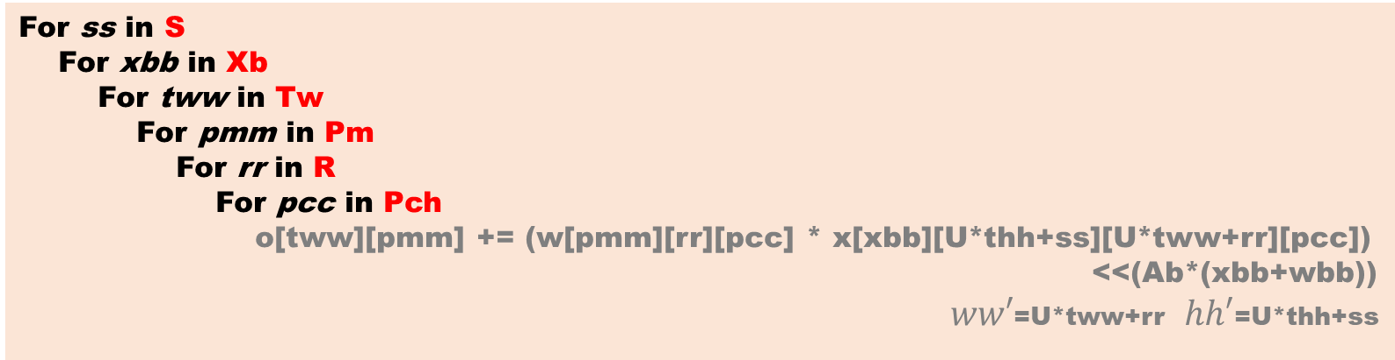
For T_{m} in M
For T_{b} in B
For T_{w} in E
For T_{h} in F
For P_{ch} in C
DRAM
For tbb in T_{b}
For thh in T_{h}
For tmm in T_{m}
For wbb in W_{b}
BUFFERs
For ss in S
For xbb in Xb
For tww in Tw
For pmm in Pm
For rr in R
For pcc in Pch
o[tww][pmm] += (w[pmm][rr][pcc] * x[xbb][U*thh+ss][U*tww+rr][pcc])
<<(Ab*(xbb+wbb))
$ww′$=U*tww+rr $hh′$=U*thh+ss
PE ARRAY

Slide 27
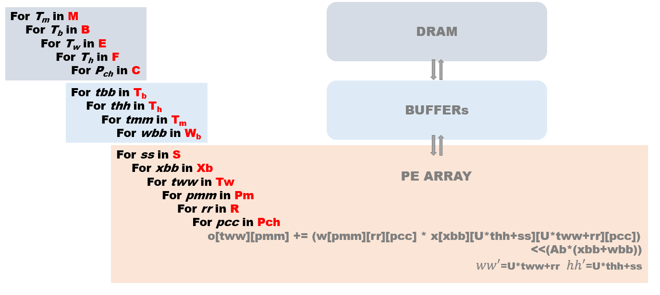

Slide 28




Input Buffer
Weight
Buffer
PE array
1D
PE
Global Buffer
Input register file
Shift dispatcher
Multiplier-adder tree
Partial sum propagater
Weight register file
Partial sum register file

Slide 29
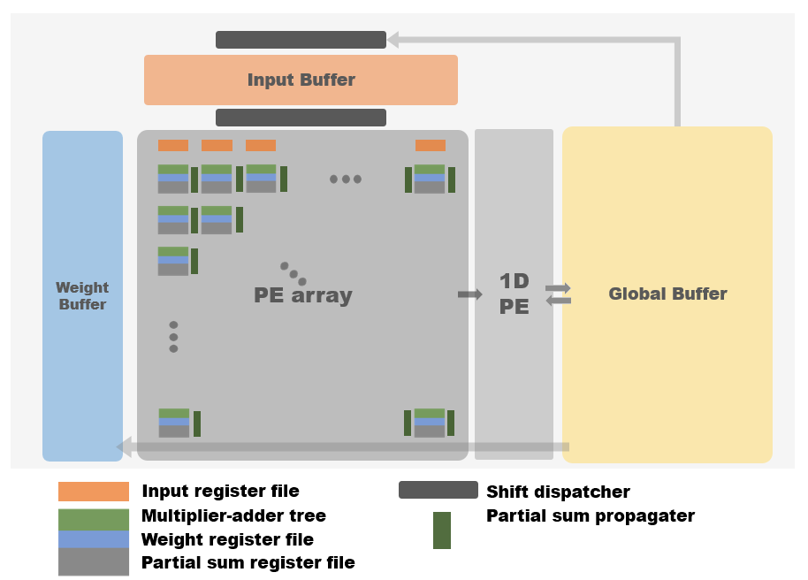

Slide 30
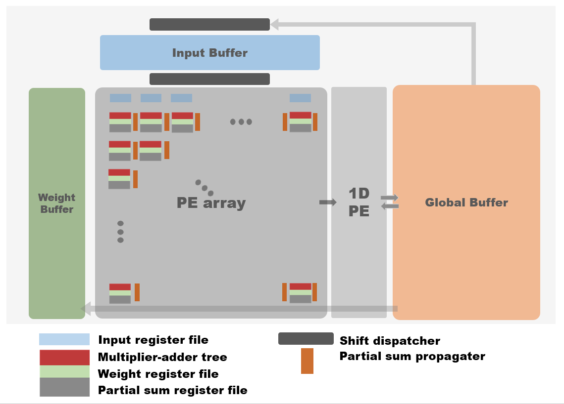

Slide 32
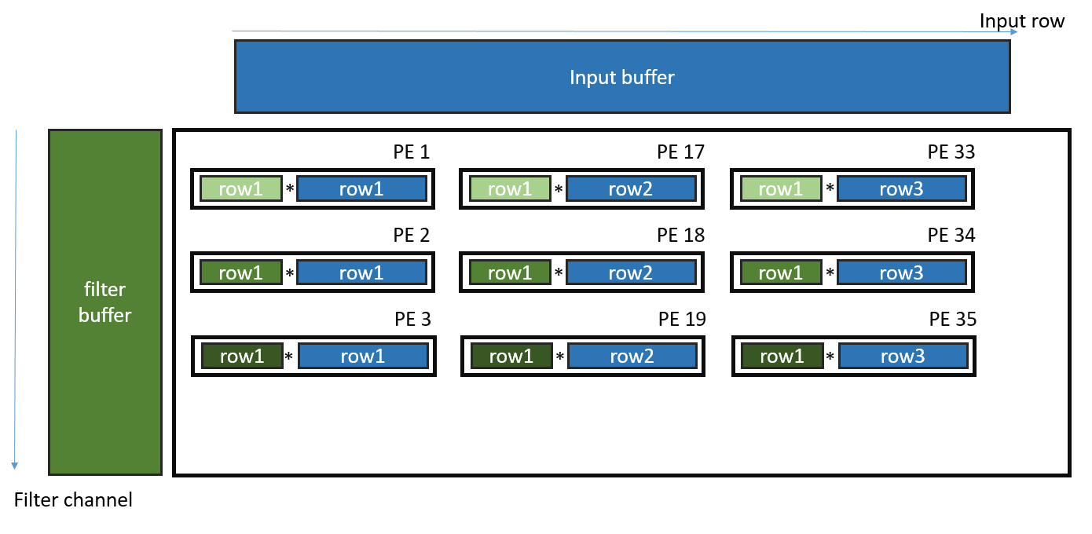
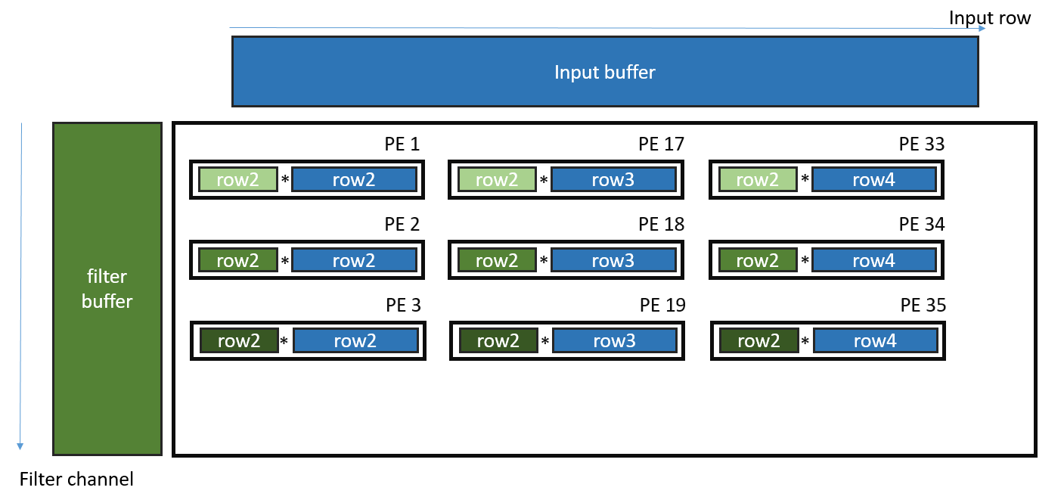
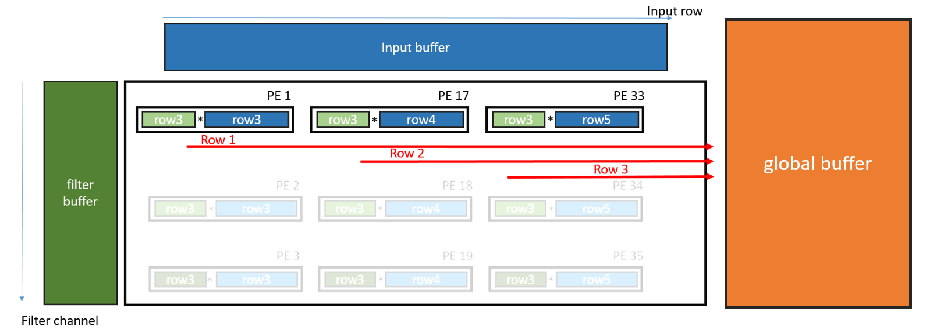
time

Slide 33
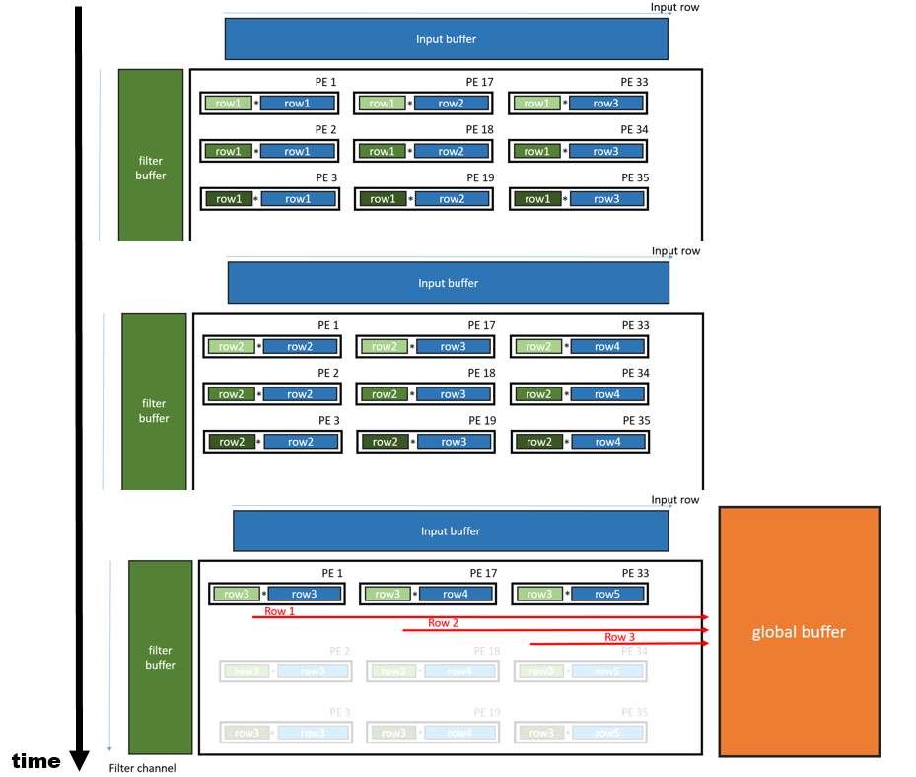

Slide 34
Input row
Input buffer
row1
row2
row3
filter buffer
PE 1
PE 17
PE 33
row1
row1
*
row1
row1
*
row2
row1
*
row3
=
row1
=
row2
=
row3
PE 2
PE 18
PE 34
row1
row1
*
row1
row1
*
row2
row1
*
row3
=
row1
=
row2
=
row3
PE 2
PE 18
PE 34
row1
row1
*
row1
row1
*
row2
row1
*
row3
Filter
channel
=
row1
=
row2
=
row3

Slide 35
Input buffer
row17
row2
row3
filter buffer
PE 1
PE 17
PE 33
row2
row2
*
row2
row2
*
row3
row2
*
row4
=
row1
=
row2
=
row3
PE 2
PE 18
PE 34
row2
row2
*
row2
row2
*
row3
row2
*
row4
=
row1
=
row2
=
row3
PE 2
PE 18
PE 34
row2
row2
*
row2
row2
*
row3
row2
*
row4
=
row1
=
row2
=
row3

Slide 36
Input buffer
row17
row18
row3
filter buffer
PE 1
PE 17
PE 33
row3
row3
*
row3
row3
*
row4
row3
*
row5
=
row1
=
row2
=
row3
PE 2
PE 18
PE 34
row3
row3
*
row3
row3
*
row4
row3
*
row5
=
row1
=
row2
=
row3
PE 2
PE 18
PE 34
row3
row3
*
row3
row3
*
row4
row3
*
row5
=
row1
=
row2
=
row3

Slide 37
Input buffer
filter buffer
PE 1
PE 17
PE 33
Global
Buffer
row1
row2
row3
PE 2
PE 18
PE 34
row1
row2
row3
PE 2
PE 18
PE 34
row1
row2
row3

Slide 38
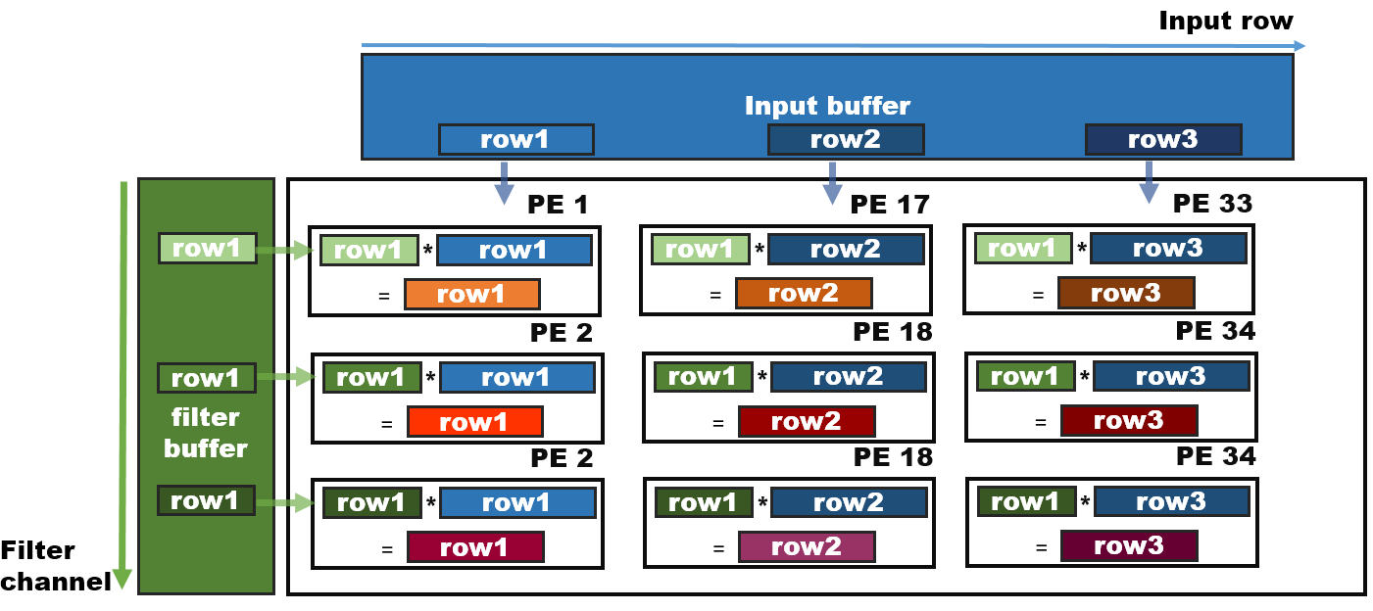

Slide 39
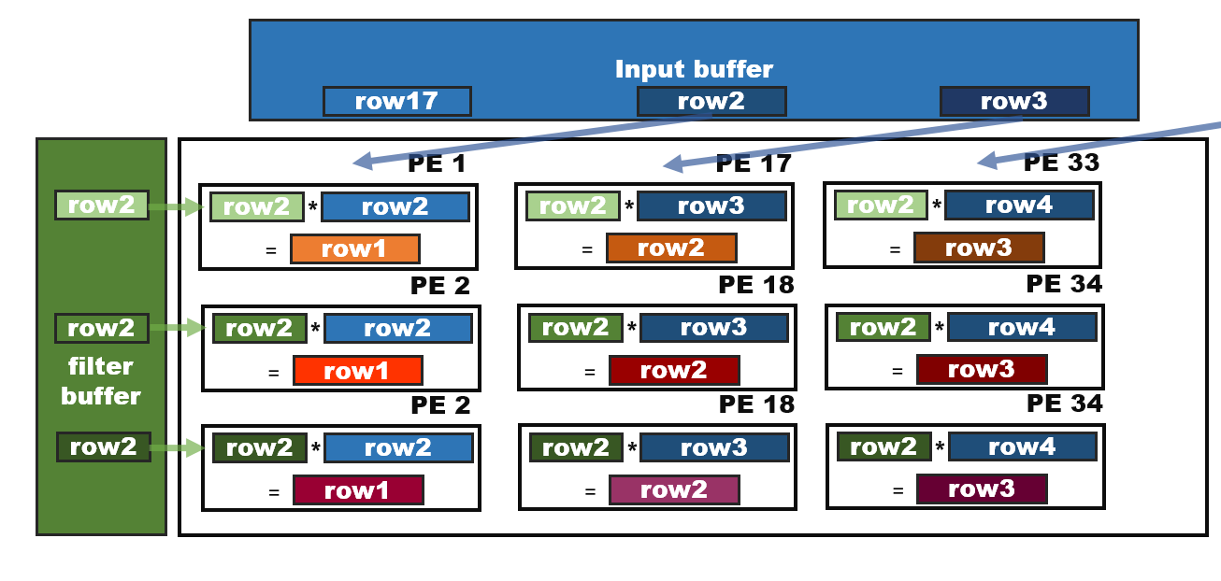

Slide 40
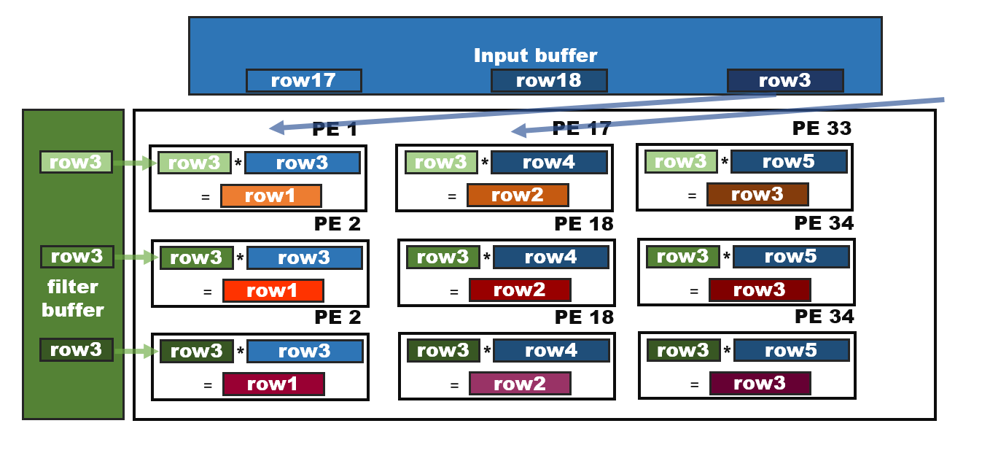

Slide 41
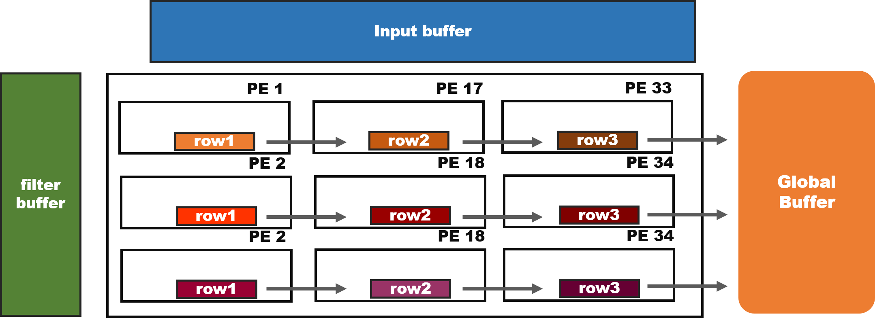

Slide 43

ww'1
ww'2
ww'3
Input Pad
pcc1
pcc2
pcc3
pcc4
*
Weight Pad
pmm1
pmm1
pmm2
pcc1
pcc2
pcc3
pcc4
rr1
rr2
rr3
Psum Pad
tww1
pmm1
pmm2
pmm3
ww'4
ww'2
ww'3
time
*
tww2
tww1
tww2
tww3
pmm1
pmm2
pmm3

Slide 44
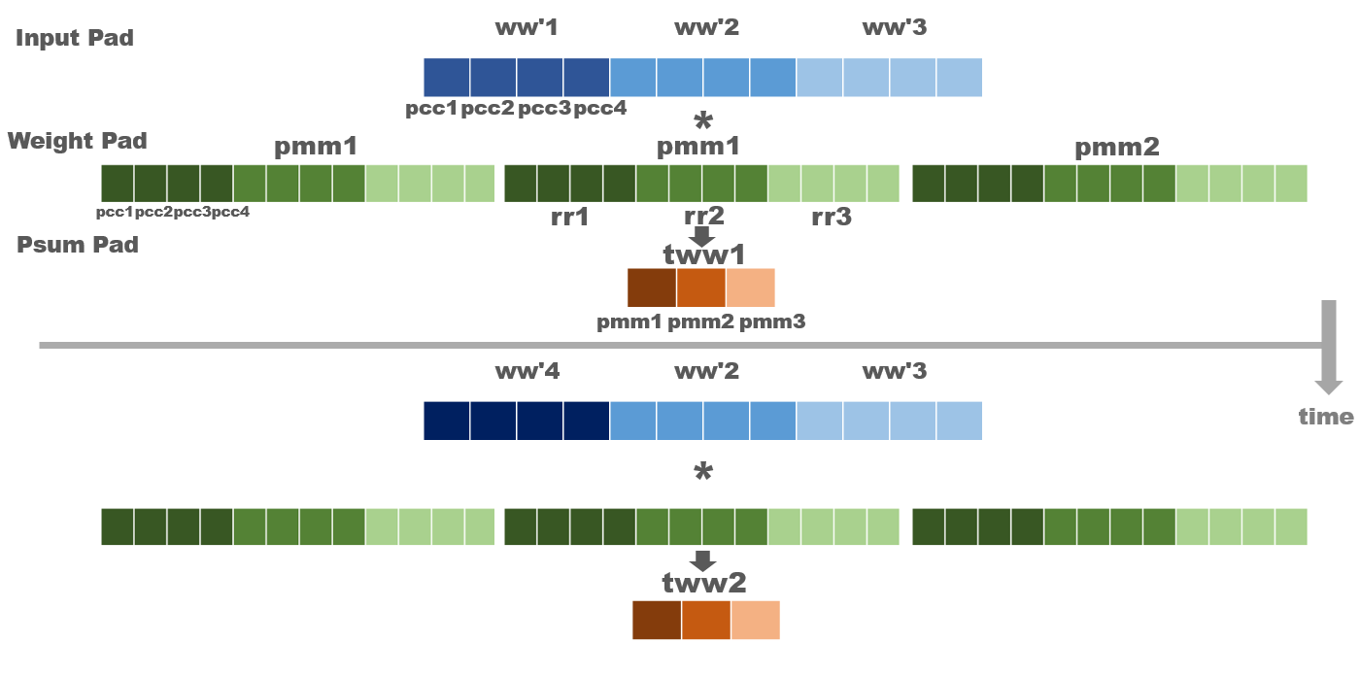

Slide 45
xbb1
xbb2
xbb3
hh'1
ww1
ww2
ww3
ww4
ww5
*
pmm1
pmm2
pmm3
ss1
rr1
rr2
rr3
thh1
tww1
tww2
tww3
xbb1
xbb2
xbb3
hh'2
time
ww1
ww2
ww3
ww4
ww5
*
ss2
thh1
tww1
tww2
tww3
To propagate path

Slide 46
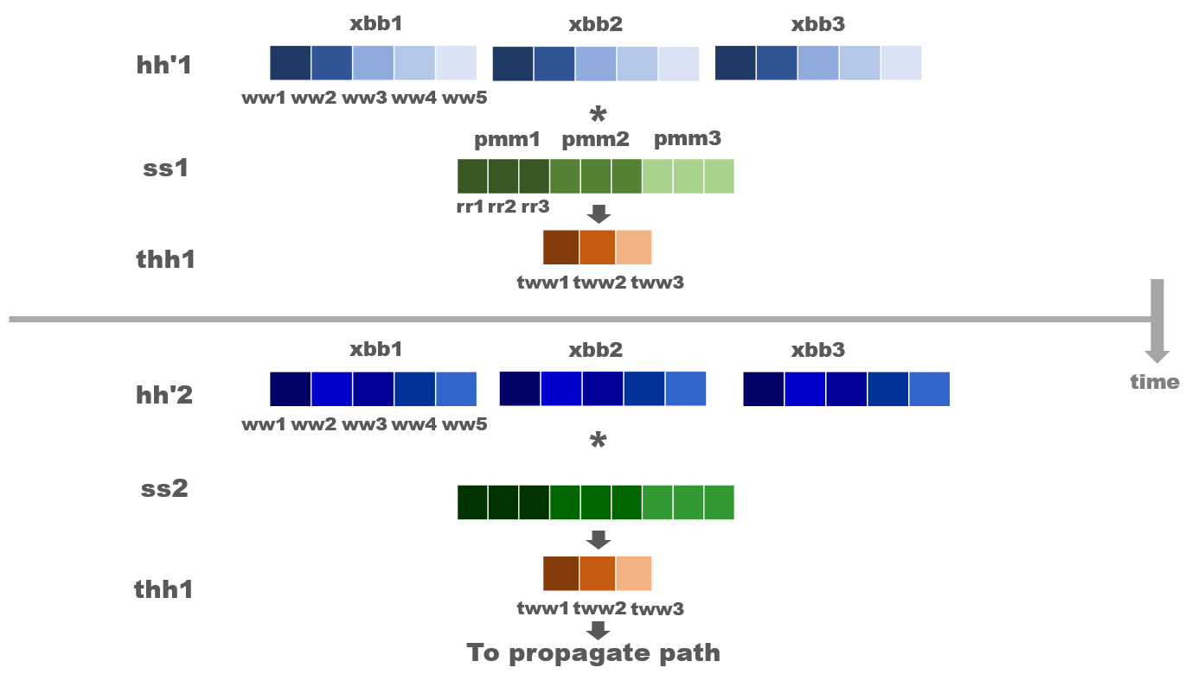

Slide 47
Row65 | Row69 | Row71
Row64 | Row68 | Row72
Row3 | Row7 | Row11
Row2 | Row6 | Row10
Row1 | Row5 | Row9
Row0 | Row4 | Row8
Row2 | Row1 | Row0
Filter0
Filter1
Filter2
Filter3

Slide 48
Row16 | Row17 | Row18
Row0 | Row1 | Row2
Row2 | Row1 | Row0
Filter0
Filter1
Filter2
Filter3

Slide 49
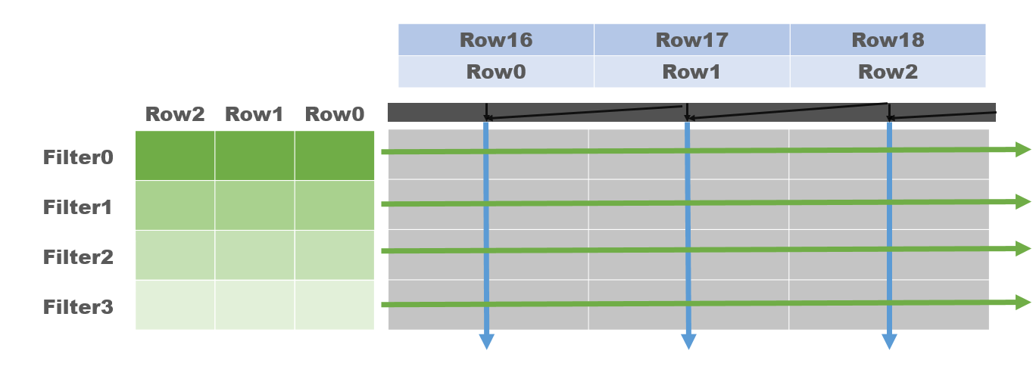
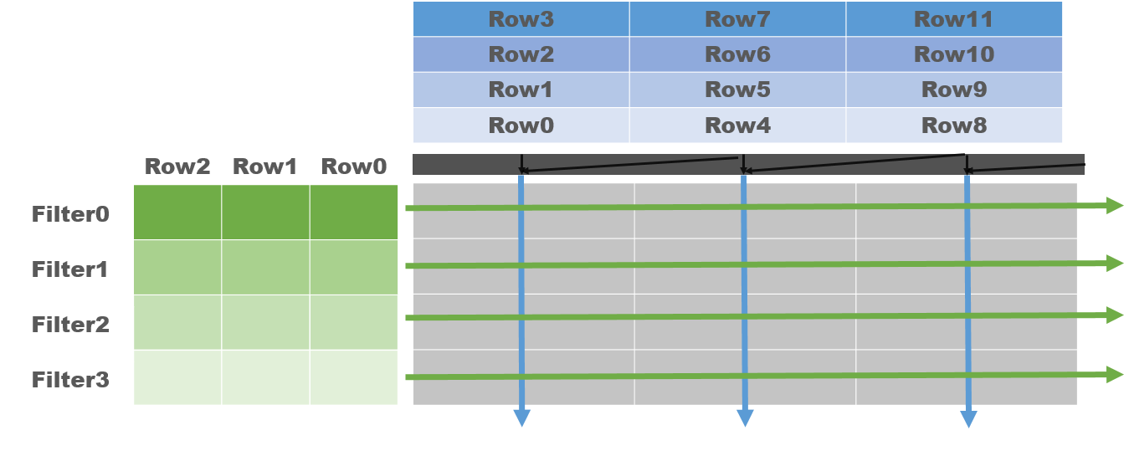
U=1
U=4

Slide 50
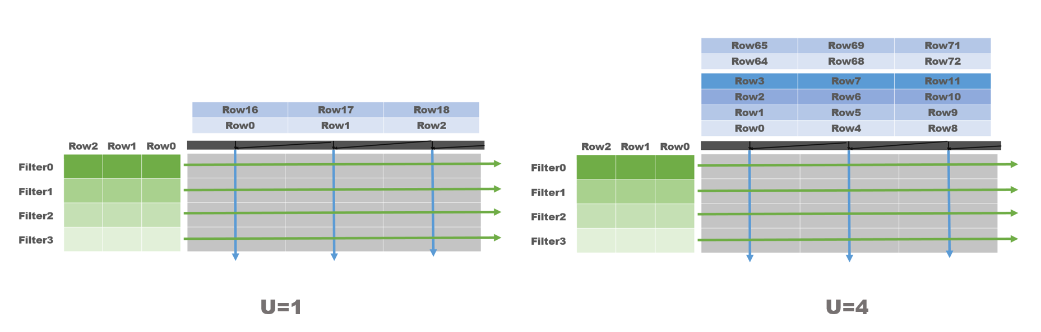

Slide 51
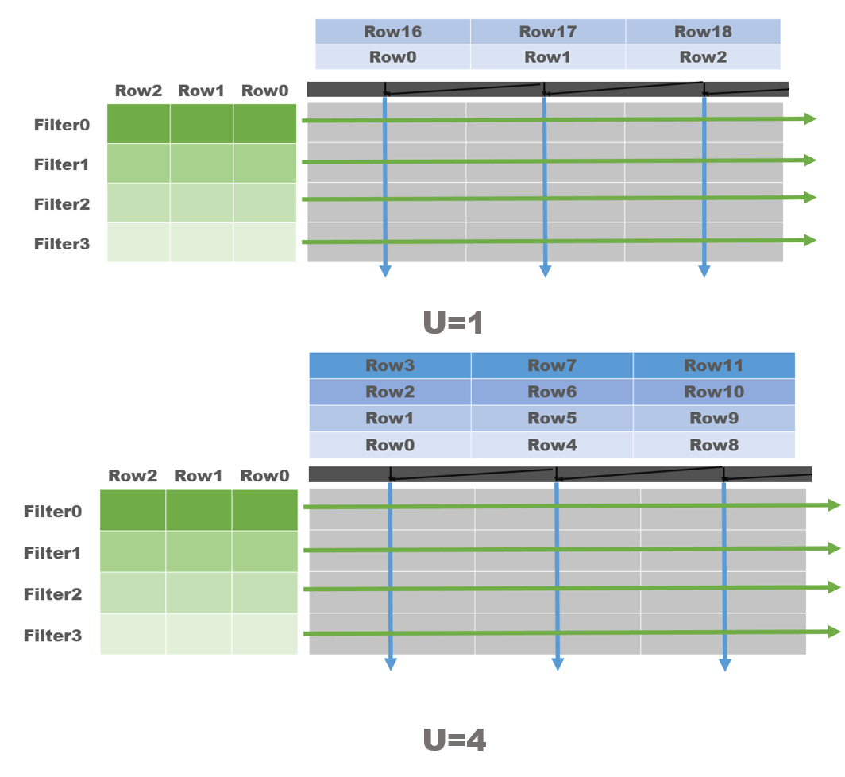

Slide 52

Weight
Final Output
Filter (0,16,32,48)
Filter (1,17,33,49)
Filter (2,18,34,50)
Filter (3,19,35,51)
C’(0,4,8,12)
C’(1,5,9,13)
C’(2,6,10,14)
C’(3,7,11,15)
Quantization
A_{b}=4
Filter (14,30,46,62)
Filter (15,31,47,63)
P_{m}=4

Slide 53
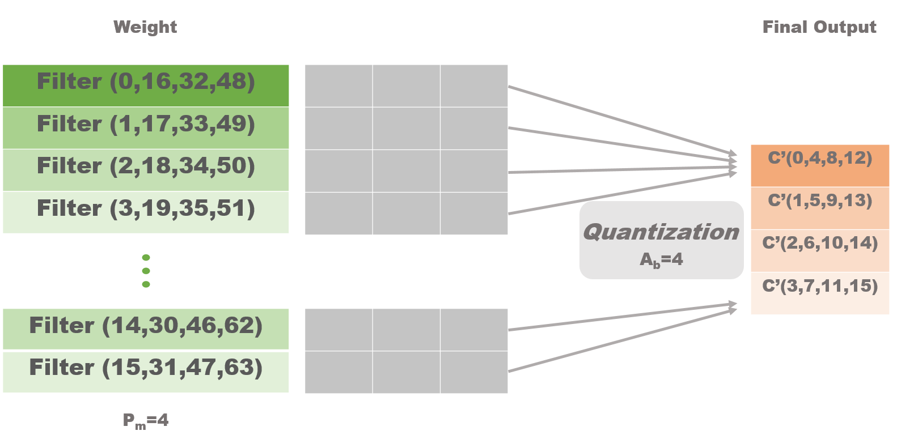

Slide 54
DataPath controller
FetchStage
MultStage
SumStage
PathStage
Multiplier
Adder
tree
Adder
Shifter
Overflow
Underflow
16x32b
IPAD
WPAD
x16
x16
x16
x16
PPAD
x16

Slide 55
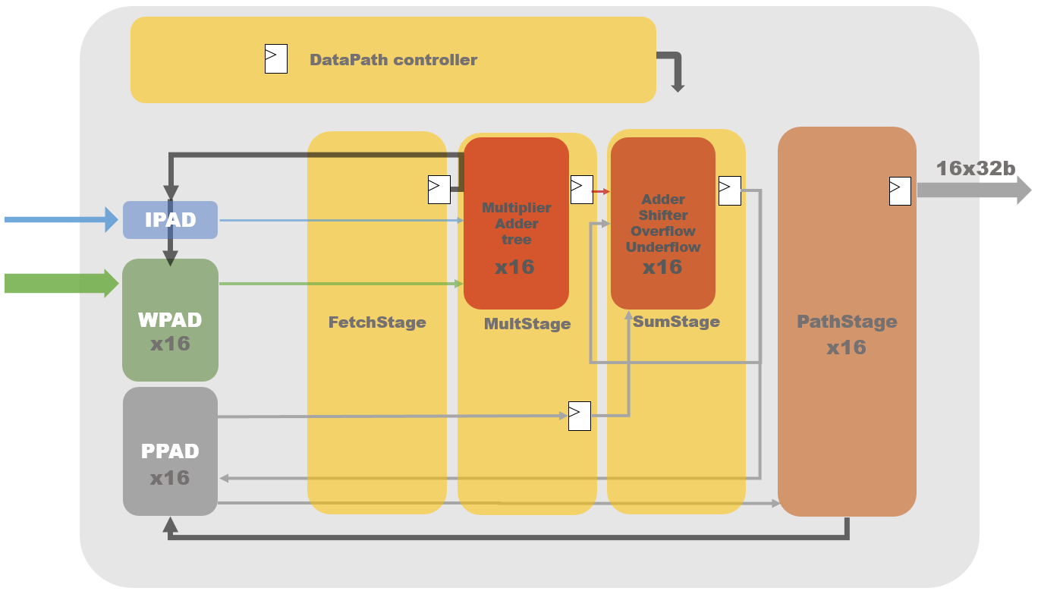

Slide 56

16b
16b
16b
16b
Ch0 | Ch1 | Ch2 | Ch3
A_{b}=4 X_{b}=1
16b
$Σ( )$
4b unsigned
4b signed
A_{b}=4 W_{b}=2
Ch0 | Ch1 | Ch2 | Ch3
LSB
MSB

Slide 57
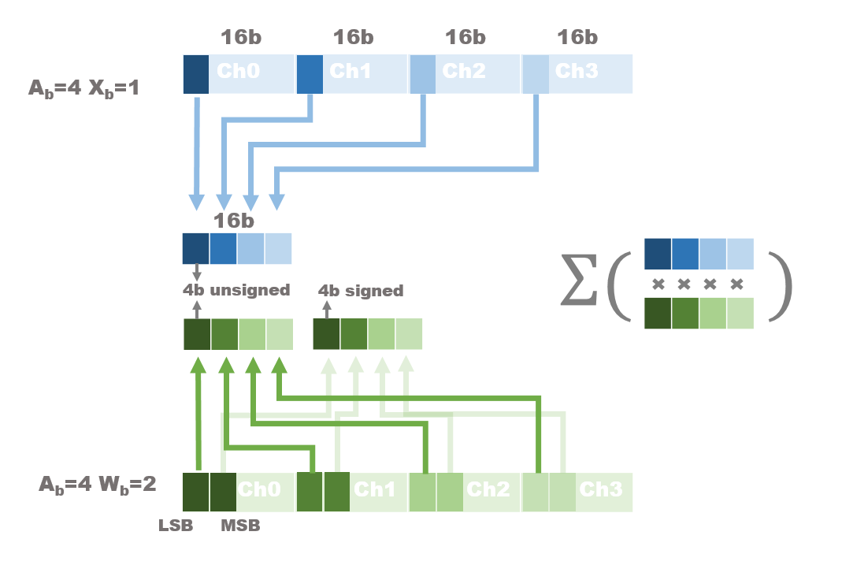

Slide 58


Slide 62
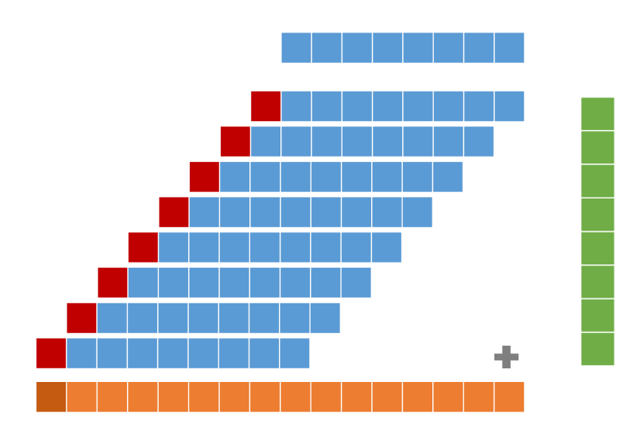
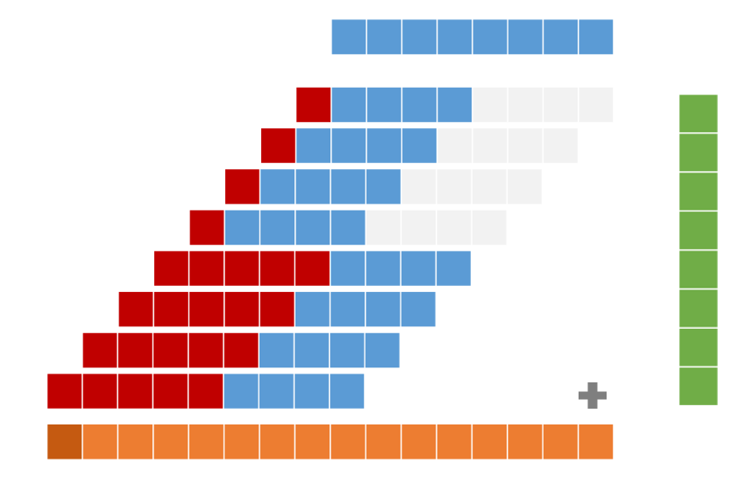
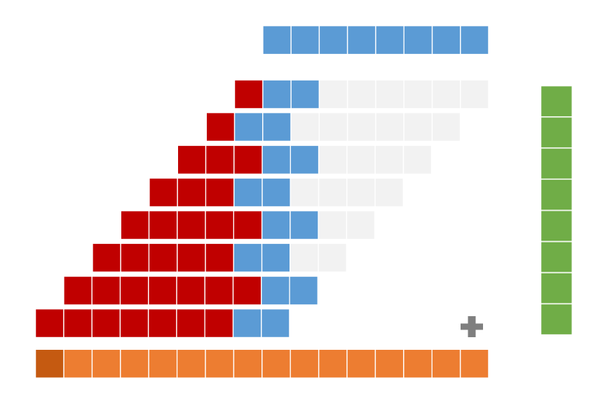
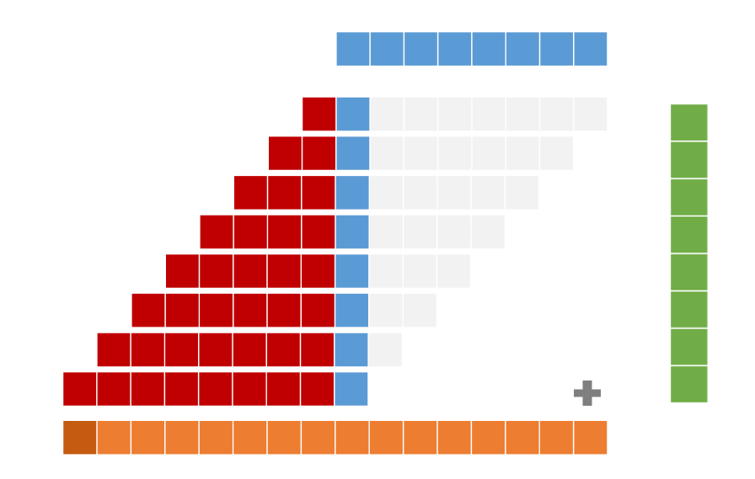
Sign extension
Zero-gated
Input
multiplicand
product

Slide 63
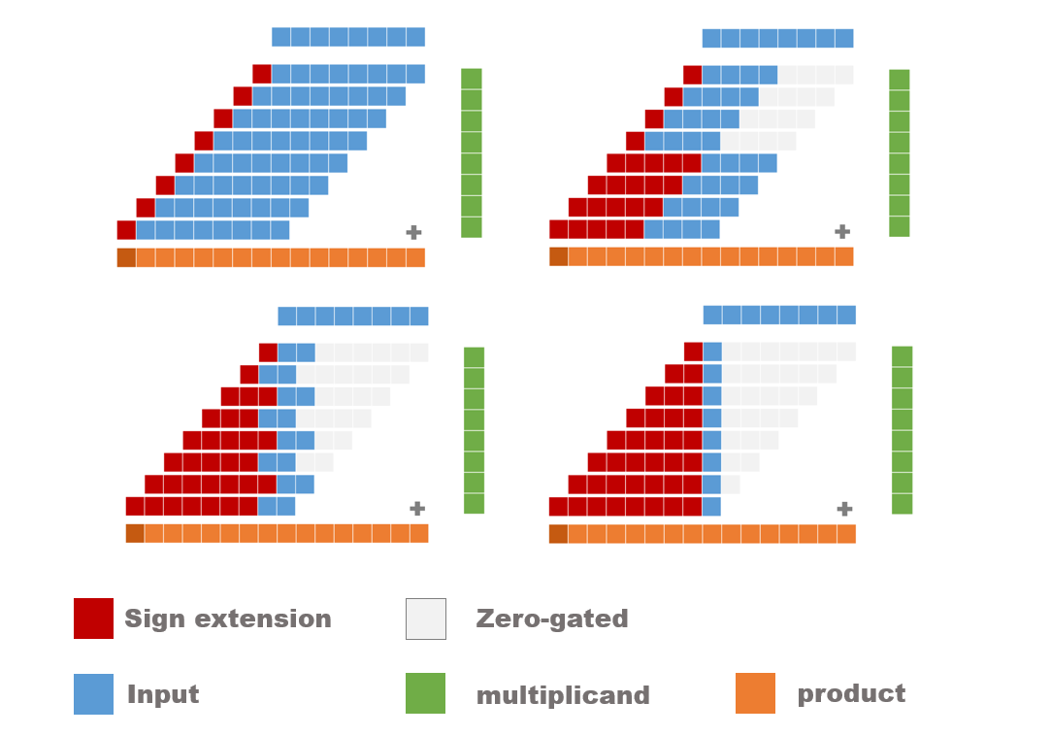

Slide 64
X_{2i+1} | X_{2i} | X_{2i-1} | PP_{i}
0 | 0 | 0 | 0
0 | 0 | 1 | Y
0 | 1 | 0 | Y
0 | 1 | 1 | 2Y
1 | 0 | 0 | -2Y
1 | 0 | 1 | -Y
1 | 1 | 0 | -Y
1 | 1 | 1 | 0
X₋₁
X₀
X₁
X₂
X₃
X₄
X₅
X₆
PP₀
PP₁

Slide 65
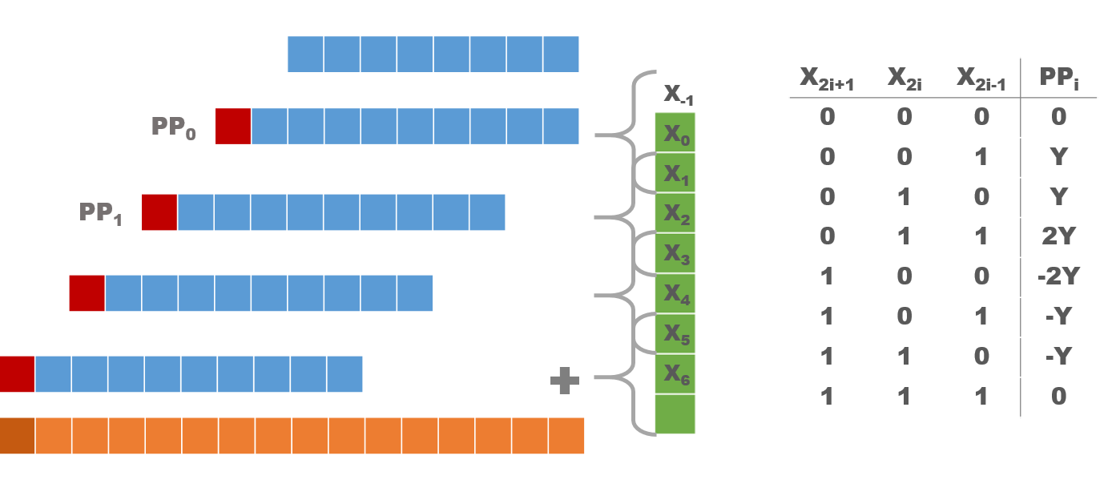

Slide 66




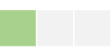
X₋₁
X₀
X₁
X₂
X₃
X₄
X₅
X₆
PP₀
PP'₁
X₃ | X₂ | X₁ | PP₁
0 | 0 | 0 | 0
0 | 1 | 0 | Y
1 | 0 | 0 | -2Y
1 | 1 | 0 | -Y
X₅ | X₄ | X₃ | PP'₂
0 | 0 | 1 | Y
0 | 0 | 0 | 0
PP₁
PP'₂
PP₂

Slide 67


Slide 68


Slide 69
16b
16b
Zero mask
16x AND/XNOR
1b adder tree
8x 2b Mult
5b adder tree
4x 4b Mult
9b adder tree
2x 8b Mult
17b adder tree
5b
2
-16
8b
11b
18b
5b
5b
5b
5b
18b

Slide 70


Slide 71
Input buffer banks
16 | 17
2 | 3 | 4 | 5 | 6 | 7 | 8 | 9 | 10 | 11 | 12 | 13 | 14 | 15
0 | 1
Shift register
Active column
Gated inactive columns
U=1
64 | 68
3 | 7
2 | 6
1 | 5
8 | 12 | 16 | 20 | 24 | 28 | 32 | 36 | 40 | 44 | 48 | 52 | 54 | 60
0 | 4
U=4

Slide 72


Slide 73
Constraints violoated

Slide 74


Slide 75
Constraints violoated

Slide 76


Slide 77

1.14x
1.19x

Slide 78


Slide 80


Slide 82


